Slide 1
Automated Black Box Testing Using
Selenium Python (Case Study: "Permohonan
Passpor Online" Web-Based Application)
ALVIAN DWI KURNIANTO
92216007
BUSINESS INFORMATION SYSTEM
SUPERVISOR: DR. Setia Wirawan

Slide 2
OUTLINE
INTRODUCTION
RESEARCH METHODOLOGY
Background
Problem Identification
Scope of Problem
Research Purposes
Research Benefits
Research Object
Research Methodology
RESULT AND DISCUSSION
CONCLUTION AND SUGGESTION
Identifying Problems
Defining Website Measurement
Developing Hypothesis
Developing & Testing Page Variation
Analyzing Test Results
Conclusion
Suggestion

Slide 3
INTRODUCTION
BACKGROUND
Small Medium Enterprise (SMEs) has an important role in encouraging the growth of the Indonesian economy.
Currently, SMEs have been the mainagenda of Indonesia’s economic development
The most prominent issue of SMEs involves providing business financing or business capital
However, to partner with banks, small businesses are required to present business proposals that are feasible or feasible and profitable
Mekar provides solutions to SMEs and other Consumers to get Financial Services Access or Capital in Indonesia.
Notes:
Testing:
- One of a good test is a test that has a high probability of finding
errors. flow
Software testing also aims to gain trust from users.
In the system development flow, testing is done after the coding process, but testing is not only seen as the last step of the system development. Testing has its own flow.
The creation of template of test plans, test cases, and test procedures is based on the format contained in IEEEStandard-829-2008 to facilitate effective testing. IEEE-Standard-829-2008 is a standard for software and system testing documentation.

Slide 4
INTRODUCTION
BACKGROUND
Some products owned by Mekar include Mekar.id main website, chat bot and website of Mekar Go.
Mekar Go Website with web address https://mekargo.id/ is a website to collect data of SMEs and employees who want to apply for a loan to Mekar
The data collected on the current version of Mekar Go Website shows the conversion of a borrower who completes the data filling from start to finish less than 10%. This conversion percentage is too small and needs to be improved.
To improve the percentage of data completion conversions, the marketing team proposes changing the order of data filling.

Slide 5
INTRODUCTION
PROBLEM IDENTIFICATION
To determine which version of mekargo.id website at PT Mekar Sampoerna Wirausaha with A / B testing which become the best version with bayesian inference method with pymc3 tools.
Notes:
Automated testing tools:
Selenium: provides a rich set of testing functions specifically geared to the needs of testing of a web application.
Selenium provides domain-specific testing languages (Selenese), for writing tests in a number of popular programming languages, including C#, Groovy, Java, Perl, PHP, Python, Ruby, and Scala.
Testing can run on any web browser and can be done on Windows, Linux, and OS X platforms.

Slide 6
INTRODUCTION
SCOPE OF PROBLEM
The object of research is the website mekargo.id.
The research was conducted at PT Mekar Sampoerna Wirausaha.
Study time between August 2017 to January 2018.
Data collection method for A / B testing techniques on mekargo.id website with the help of Google Analytics tools.
The generated data from A / B testing is analyzed by Bayesian inference analysis using pymc3, numpy, matplotlib, scipy, jupyter and Ipython tools with python programming language.
Mekargo.id website features that studied is a feature of input data by borrower.
Mekargo.id website feature that is not discussed is a static page feature that contains the home page, about us, terms and conditions, privacy policy and contact us.
Notes:
Electronic government (e-gov) is an application of communication and information technology that can change the ability of the government in providing services to the public.
These website can give benefits to the society and government, because their service being faster because they are accessible for 24 hours for 7 days and do not limit places.

Slide 7
INTRODUCTION
RESEARCH PURPOSES
To know the version of A / B testing which is the best version of mekargo.id website at PT Mekar Sampoerna Entrepreneurship with bayesian inference method with pymc3.
Notes:
This website can already be used but still in the development and improvement phase of the application, so the addition of modules or module improvements will continue to be done.
It needs automated black box testing for more accurate and time-saving testing.

Slide 8
INTRODUCTION
RESEARCH BENEFITS
For the researcher, be a guide or research reference in the field of information system in A / B testing with bayessian inference method.
For other researchers, as a literature source for A / B testing with bayessian inference method.
For the company under study, provide an alternative to solving the problem of choosing the best version with A / B testing.

Slide 9
RESEARCH METHODOLOGY
RESEARCH OBJECT
The time of the study was conducted between August 2017 and January 2018.
The object of this research is Mekar’s Mekargo.id website.
The feature studied in this research is the registration feature for the borrower.
The data used is the url address that the registrant visits for each version of A / B testing.
Data collection is done with google analytics tools.
The data obtained will then be analyzed by bayesian inference and pymc3 as
tool.
Notes:
In determining the features to be tested, the researcher tested the black box manually to be used as a reference when performing automated black box testing using Selenium Python, then performed an automated test outline to determine the features will be tested and features that will not be tested.
Feature not to be tested:
Reset Password feature cannot be tested using Selenium Python because it is problematic with authentication of Gmail
The "Buat Permohonan" feature is selected 1 Immigration Office(Kanim Kantor Imigrasi), i.e. Kanim Banda Aceh because only on that Kanim, "Pilih Tanggal" button still available request date.
On this feature, tested only for 1 applicant due to limited quota.

Slide 10
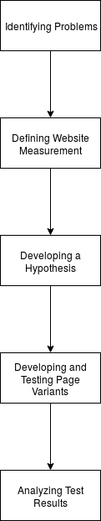
RESEARCH METHODOLOGY
METHODOLOGY
Notes:
From 5 steps, got 3 steps taken due to this research is not done by a team of testers from the software engineer of an organization, researcher adjust the model testing process in accordance with the conditions of testing conducted by researchers.

Slide 11
RESEARCH METHODOLOGY
METHODOLOGY
Identifying Problems
Problems identified are issues related to the website to be performed A / B testing
The problems are usually related to business, marketing, or convertion rate
The problem described is usually because there is something that arises that does not match the goal.
Notes:
The use of IEEE-829-2008 outline start from the stage of test planning, test design, test cases / test procedures and execution, and test reports reporting. In this research, it was decided that this research was not carried out until the test results reporting stage because Selenium Python did not support the test result reporting.
Due to the research is done not by a team of testers from the software engineer of an organization, the researcher adjust the template as the picture above.

Slide 12
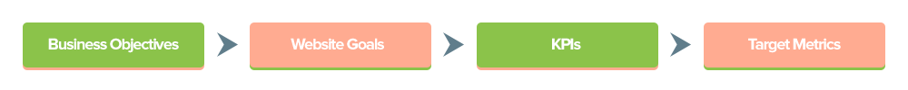
RESEARCH METHODOLOGY
METHODOLOGY
Defining Website Measurement
Notes:
The use of IEEE-829-2008 outline start from the stage of test planning, test design, test cases / test procedures and execution, and test reports reporting. In this research, it was decided that this research was not carried out until the test results reporting stage because Selenium Python did not support the test result reporting.
Due to the research is done not by a team of testers from the software engineer of an organization, the researcher adjust the template as the picture above.

Slide 13
RESEARCH METHODOLOGY
METHODOLOGY
Developing a Hypothesis
How to Develop Hypothesis
Case Studies
Relevancy
Audience overlap
Accuracy
Recency
Scope
Case Studies
Convention
Theory
Testing
Recency
Scope
Theory
Experience
Notes:
The use of IEEE-829-2008 outline start from the stage of test planning, test design, test cases / test procedures and execution, and test reports reporting. In this research, it was decided that this research was not carried out until the test results reporting stage because Selenium Python did not support the test result reporting.
Due to the research is done not by a team of testers from the software engineer of an organization, the researcher adjust the template as the picture above.

Slide 14
RESEARCH METHODOLOGY
METHODOLOGY
Developing & Testing Page Variants
Developing test variants contain field changes on the form from the previous version.
There is also the definition of the page name accompanied by the url that represents the page.
Testing page variants contains an explanation of the implementation of Google Analytics on the entire page.
The results of its implementation are seen in the dashboard of Google Analytics account and extracting data.
Notes:
The use of IEEE-829-2008 outline start from the stage of test planning, test design, test cases / test procedures and execution, and test reports reporting. In this research, it was decided that this research was not carried out until the test results reporting stage because Selenium Python did not support the test result reporting.
Due to the research is done not by a team of testers from the software engineer of an organization, the researcher adjust the template as the picture above.

Slide 15
RESEARCH METHODOLOGY
METHODOLOGY
Analyzing Test Results
Bayessian Inference Algorithm
Bernoulli Distribution
Pymc3
Metropolis-Hastings Algorithm
Notes:
The use of IEEE-829-2008 outline start from the stage of test planning, test design, test cases / test procedures and execution, and test reports reporting. In this research, it was decided that this research was not carried out until the test results reporting stage because Selenium Python did not support the test result reporting.
Due to the research is done not by a team of testers from the software engineer of an organization, the researcher adjust the template as the picture above.

Slide 16
RESULT & DISCUSSION
IDENTIFYING PROBLEMS
Mekar Go is a website used to collect borrower data.
The data collected on the current version of Mekar Go website shows the conversion of a borrower who completes data filling from start to finish less than 10%.
This conversion percentage by the marketing team is too small and needs to be improved.
Notes:
Document identifier, filled with Saved where file (the document storage directory) for this research this fil will be saved in the directory E:\Kuliah\S2\Tesis, Date (date of document creation), and Version of this plan (the version of the test plan to be filled in with the test date)
Scope is filled with the purpose of this testing
References are filled out with applicable documentation references.
System overview and key features are filled with explanations of the purpose and key features of “Permohonan Paspor Online” web-based application.
Test overview is filled with an explanation of the tools, techniques, and methods required in automated black box testing of “Permohonan Paspor Online” web-based application.

Slide 17
RESULT & DISCUSSION
DEFINING WEBSITE MEASUREMENT
Business Objective
Website Goal
Key Performance Metric
Target Metric
Notes:
Document identifier, filled with Saved where file (the document storage directory) for this research this fil will be saved in the directory E:\Kuliah\S2\Tesis, Date (date of document creation), and Version of this plan (the version of the test plan to be filled in with the test date)
Scope is filled with the purpose of this testing
References are filled out with applicable documentation references.
System overview and key features are filled with explanations of the purpose and key features of “Permohonan Paspor Online” web-based application.
Test overview is filled with an explanation of the tools, techniques, and methods required in automated black box testing of “Permohonan Paspor Online” web-based application.

Slide 18
RESULT & DISCUSSION
DEVELOPING A HYPOTHESIS
The completion percentage of the registration form filling is influenced by the order of form filling
The proposed solution is to test A / B testing against two new versions along with simplification and increment of data filling
The initial assumption, one of the two new versions will be better than the previous version
Notes:
Document identifier, filled with Saved where file (the document storage directory) for this research this fil will be saved in the directory E:\Kuliah\S2\Tesis, Date (date of document creation), and Version of this plan (the version of the test plan to be filled in with the test date)
Scope is filled with the purpose of this testing
References are filled out with applicable documentation references.
System overview and key features are filled with explanations of the purpose and key features of “Permohonan Paspor Online” web-based application.
Test overview is filled with an explanation of the tools, techniques, and methods required in automated black box testing of “Permohonan Paspor Online” web-based application.

Slide 19
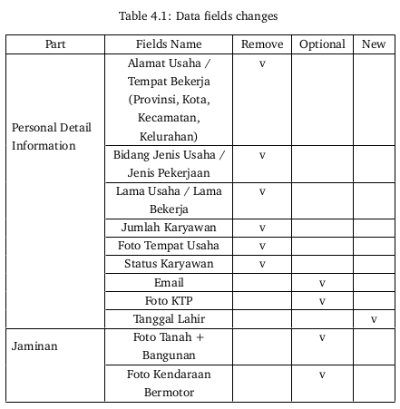
RESULT & DISCUSSION
DEVELOPING & TESTING PAGE VARIANTS
Developing Page Variants
Notes:
Document identifier, filled with Saved where file (the document storage directory) for this research this fil will be saved in the directory E:\Kuliah\S2\Tesis, Date (date of document creation), and Version of this plan (the version of the test plan to be filled in with the test date)
Scope is filled with the purpose of this testing
References are filled out with applicable documentation references.
System overview and key features are filled with explanations of the purpose and key features of “Permohonan Paspor Online” web-based application.
Test overview is filled with an explanation of the tools, techniques, and methods required in automated black box testing of “Permohonan Paspor Online” web-based application.

Slide 20
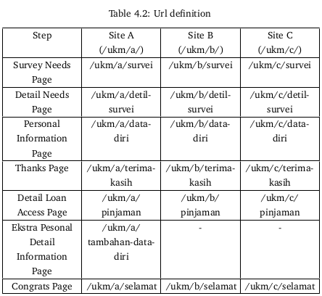
RESULT & DISCUSSION
DEVELOPING & TESTING PAGE VARIANTS
Developing Page Variants
Notes:
Document identifier, filled with Saved where file (the document storage directory) for this research this fil will be saved in the directory E:\Kuliah\S2\Tesis, Date (date of document creation), and Version of this plan (the version of the test plan to be filled in with the test date)
Scope is filled with the purpose of this testing
References are filled out with applicable documentation references.
System overview and key features are filled with explanations of the purpose and key features of “Permohonan Paspor Online” web-based application.
Test overview is filled with an explanation of the tools, techniques, and methods required in automated black box testing of “Permohonan Paspor Online” web-based application.

Slide 21
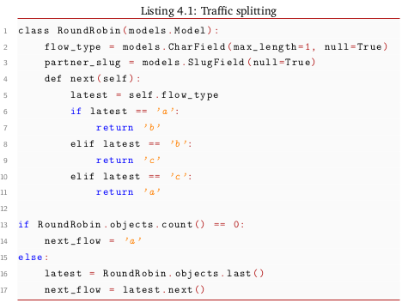
RESULT & DISCUSSION
DEVELOPING & TESTING PAGE VARIANTS
Developing Page Variants
Notes:
Document identifier, filled with Saved where file (the document storage directory) for this research this fil will be saved in the directory E:\Kuliah\S2\Tesis, Date (date of document creation), and Version of this plan (the version of the test plan to be filled in with the test date)
Scope is filled with the purpose of this testing
References are filled out with applicable documentation references.
System overview and key features are filled with explanations of the purpose and key features of “Permohonan Paspor Online” web-based application.
Test overview is filled with an explanation of the tools, techniques, and methods required in automated black box testing of “Permohonan Paspor Online” web-based application.

Slide 22
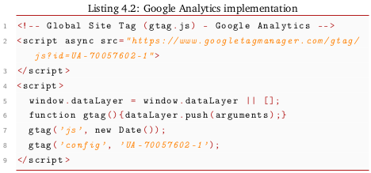
RESULT & DISCUSSION
DEVELOPING & TESTING PAGE VARIANTS
Testing Page Variants
Notes:
Document identifier, filled with Saved where file (the document storage directory) for this research this fil will be saved in the directory E:\Kuliah\S2\Tesis, Date (date of document creation), and Version of this plan (the version of the test plan to be filled in with the test date)
Scope is filled with the purpose of this testing
References are filled out with applicable documentation references.
System overview and key features are filled with explanations of the purpose and key features of “Permohonan Paspor Online” web-based application.
Test overview is filled with an explanation of the tools, techniques, and methods required in automated black box testing of “Permohonan Paspor Online” web-based application.

Slide 23
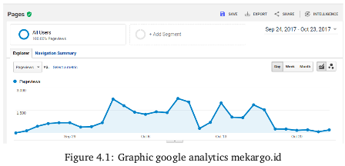
RESULT & DISCUSSION
DEVELOPING & TESTING PAGE VARIANTS
Testing Page Variants
Notes:
Document identifier, filled with Saved where file (the document storage directory) for this research this fil will be saved in the directory E:\Kuliah\S2\Tesis, Date (date of document creation), and Version of this plan (the version of the test plan to be filled in with the test date)
Scope is filled with the purpose of this testing
References are filled out with applicable documentation references.
System overview and key features are filled with explanations of the purpose and key features of “Permohonan Paspor Online” web-based application.
Test overview is filled with an explanation of the tools, techniques, and methods required in automated black box testing of “Permohonan Paspor Online” web-based application.

Slide 24
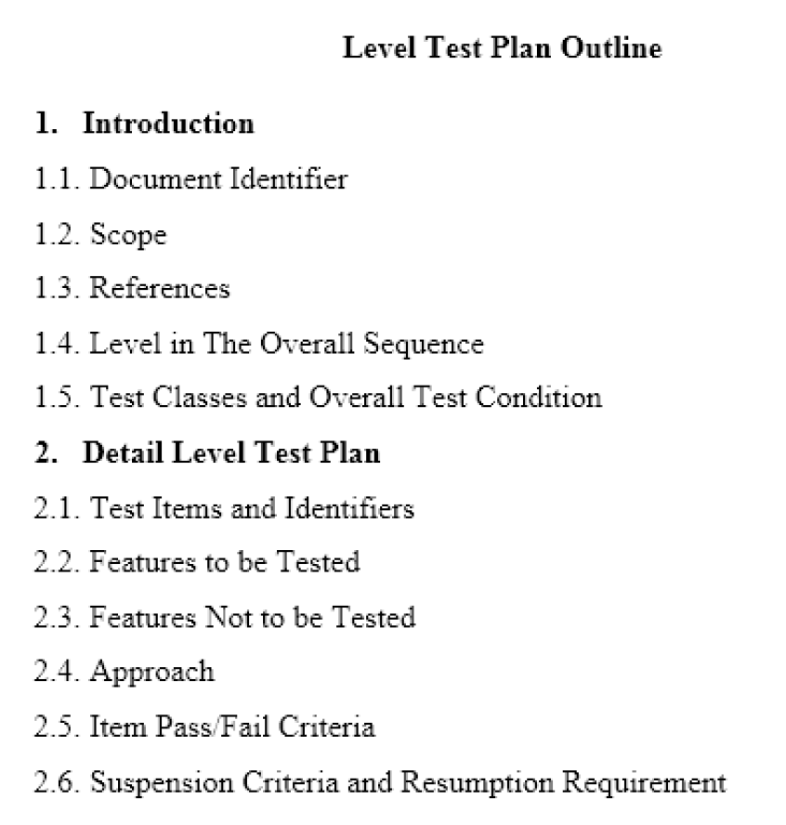
RESEARCH METHOD
CREATE TEST DESIGN
LEVEL TEST PLAN
Notes:
Level in the overall sequence is filled by a test hierarchy, in this case it will show the navigation structure of "Permohonan Paspor Online" web-based application because the research perform the test based on the navigation system of application.
Test classes and overall test condition is filled by the additional detail of scope, for example: in the feature of “Buat Permohonan” tested for only 1 applicant.
Test item and identifier, filled by identification of requirement, user guides, and hardware of "Permohonan Paspor Online" web-based application.
Features to be tested are filled by features of "Permohonan Paspor Online” web-based application that will be tested by automated black box testing using selenium python.
Features not to be tested are filled by features of "Permohonan Paspor Online" web-based application that will not be tested by automated black box testing using selenium python.
The approach is filled in with the overall approach of level test. In this case, it used is black box testing approach.
The item pass/failed criteria are filled by pass/failed item specifications in testing.
Suspension criteria and resumption requirement filled by laid-off testing activities due to something and to restart a certain way.

Slide 25
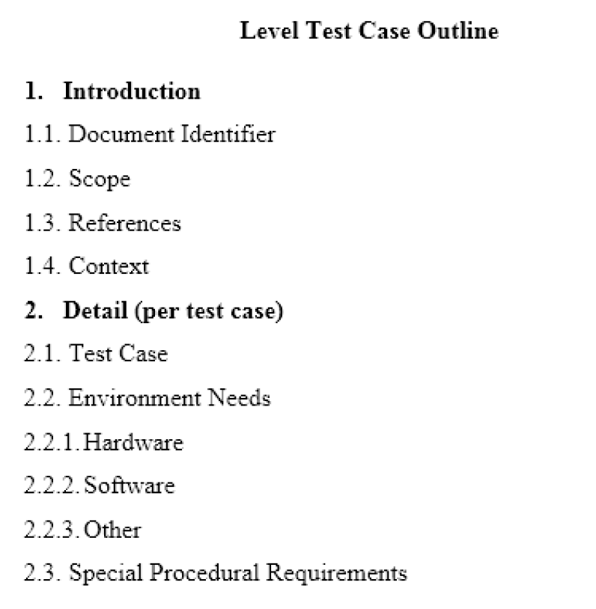
RESEARCH METHOD
CREATE TEST CASE AND TEST PROCEDURE
LEVEL TEST CASE
Notes:
Context is filled out about third parties to fulfill the need for automated black box testing of "Permohonan Paspor Online” web-based application.
The test case are filled with an identifier, test item, and output of "Permohonan Paspor Online" web-based application.
Environmental requirements are filled with test preparation, execution, and recording of automated black box testing of the application,
The hardware is filled with hardware specifications that used when execute automatic black box testing of "Permohonan Paspor Online" web-based application.
The software is filled with the software configuration specifications that required to perform automated black box testing of "Permohonan Paspor Online" web-based application.
Others are filled with other needs in automated black box testing, such as third parties from the environment.
Specific procedural requirements are filled in with special limits on automated black box testing of this application.

Slide 26
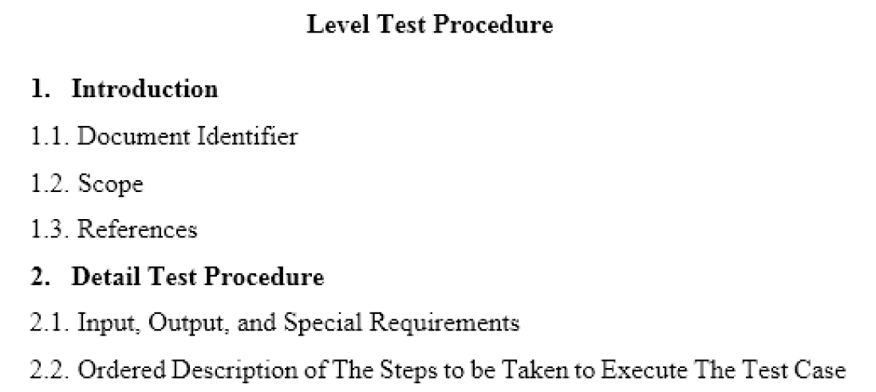
RESEARCH METHOD
CREATE TEST CASE AND TEST PROCEDURE
LEVEL TEST PROCEDURE
Notes:
The inputs, outputs and special requirements are filled out about all identification required to perform automatic black box testing of “Permohonan Paspor Online” web-based application, including tools, test cases, and third parties. Special requirements will be filled out with the special requirement that required during the test.
The description, the steps are taken to execute the case are filled out about the procedure steps of the application.

Slide 27
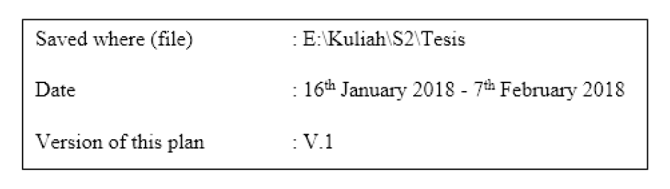
RESULT AND ANALYSIS
TEST PLAN
MASTER TEST PLAN
Document Identifier
Other explanation can be seen in here (in Tesis Bab 4.xlsx)

Slide 28
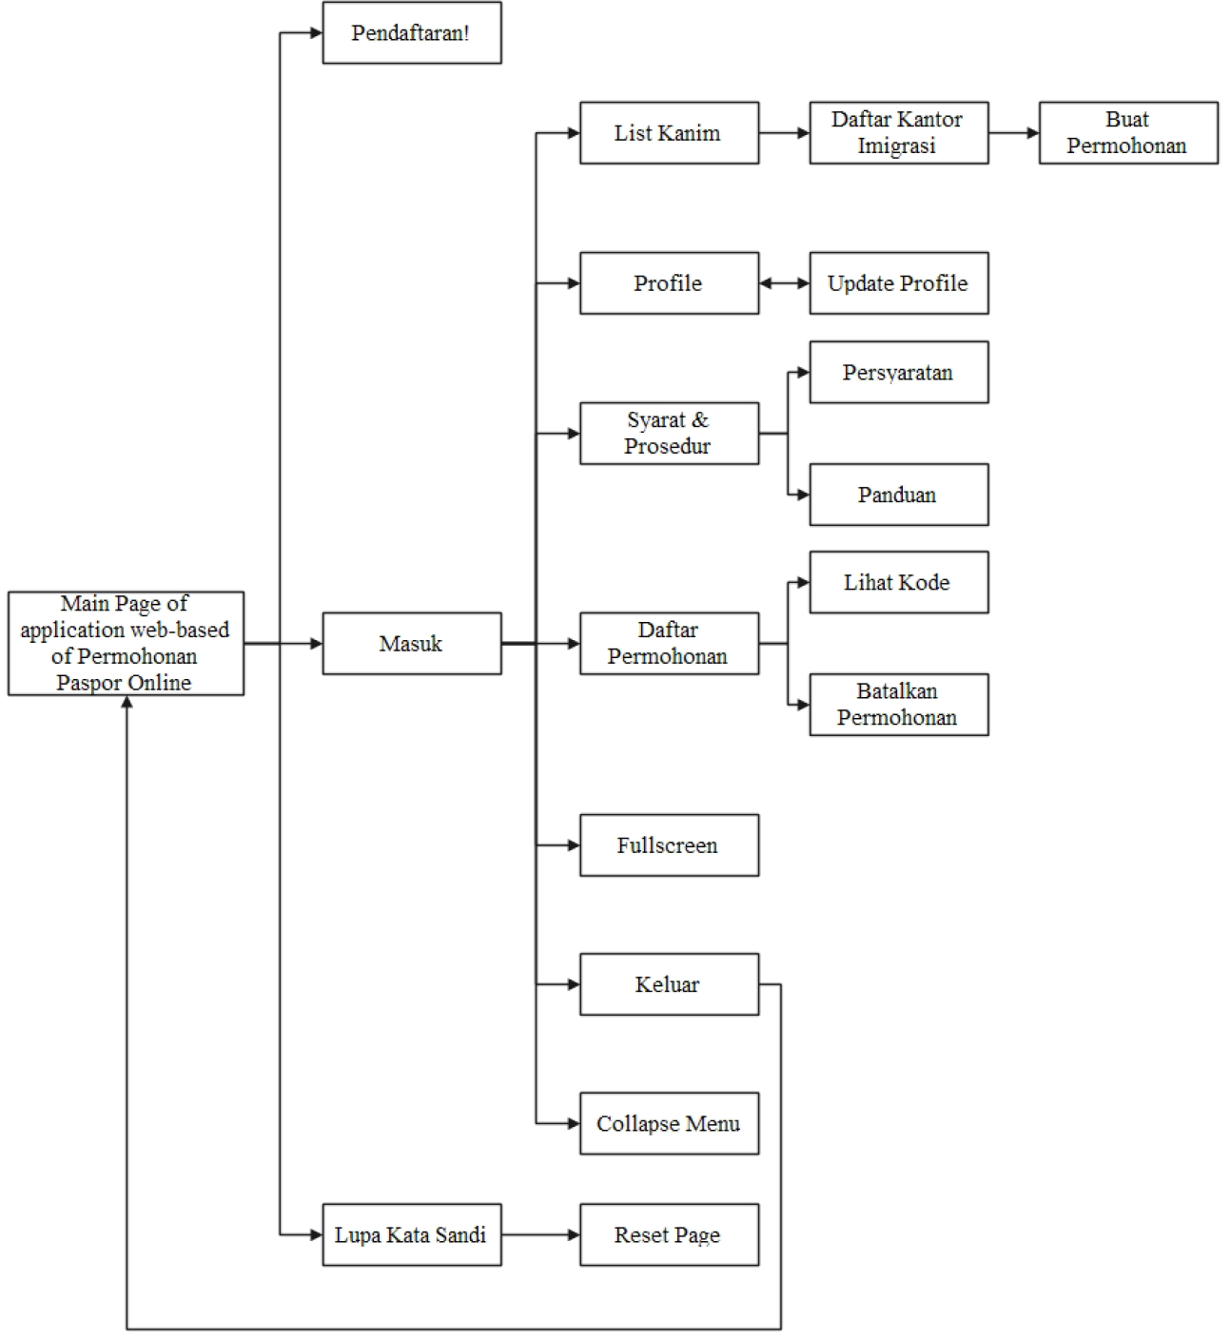
RESULT AND ANALYSIS
TEST PLAN
LEVEL TEST PLAN
Level in the overall test condition

Slide 29
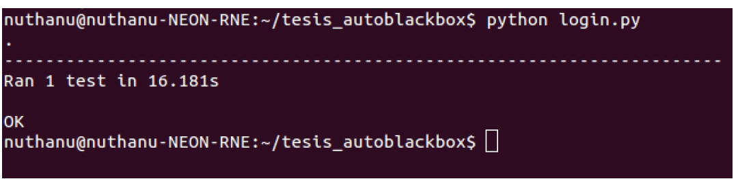
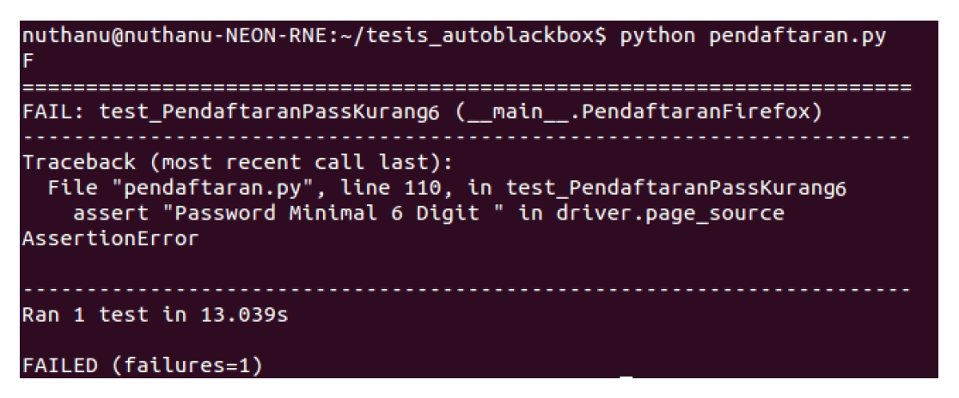
RESULT AND ANALYSIS
TEST PLAN
LEVEL TEST PLAN
Other explanation can be seen in here (in Tesis Bab 4.xlsx)
The item pass/failed criteria

Slide 30
RESULT AND ANALYSIS
TEST CASE AND TEST PROCEDURE
TEST CASE
Test Case can be seen in here ([EN] - Thesis_nuthanu-v6-fix.pdf in Chapter 4, Test Case)

Slide 31
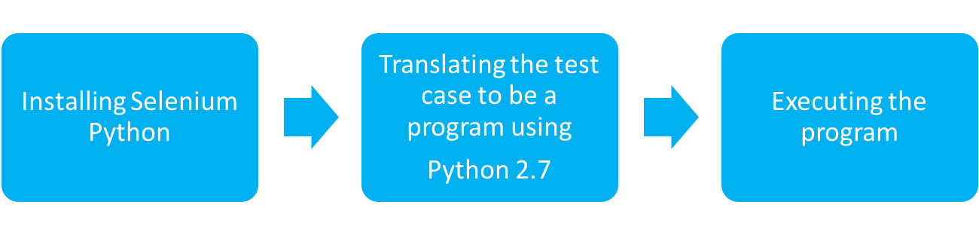
RESULT AND ANALYSIS
TEST CASE AND TEST PROCEDURE
TEST PROCEDURE
Test Case can be seen in here ([EN] - Thesis_nuthanu-v6-fix.pdf in Chapter 4, Test Case)
The steps to be taken to execute the test case, there are 3 steps:

Slide 32

RESULT AND ANALYSIS
TEST CASE AND TEST PROCEDURE
TEST PROCEDURE
Installing Selenium Python, in ubuntu:

Slide 33
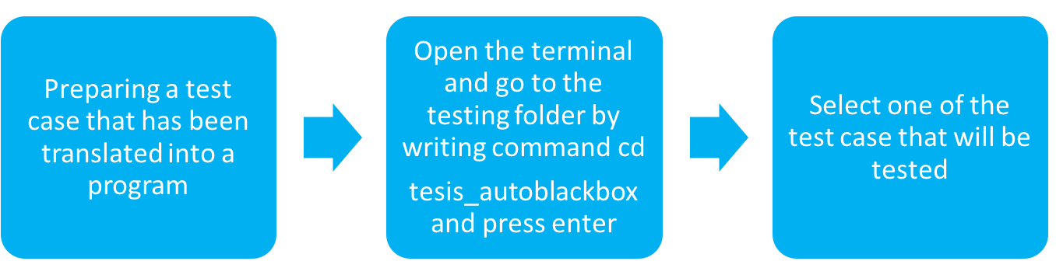
RESULT AND ANALYSIS
TEST CASE AND TEST PROCEDURE
TEST PROCEDURE
Executing Program (demo)

Slide 34
RESULT AND ANALYSIS
PERFORM TESTING
Page | Test Case(s)
Login | 4
Lupa Kata Sandi | 4
Pendaftaran | 16
Buat Permohonan | 8
Profile | 31
Syarat & Prosedur | 3
Daftar Permohonan | 5
Header Button | 5
Total | 76

Slide 35
RESULT AND ANALYSIS
ANALYSIS
RESULTS
Results can be seen in here (in Tesis Bab 4.xlsx)

Slide 36
CONCLUSION REMARKS
CONCLUSION
Overall, from the results of the automated black box testing using Selenium Python in "Permohonan Paspor Online" web-based application that has been done, it found 5 invalid test cases of 76 test cases made based on the features tested.
The invalid test case could be found in feature Pendaftaran and Profile

Slide 37
CONCLUSION REMARKS
CONCLUSION
Invalid Test Cases | Pendaftaran | Profile
 | Register by fill Password field less than 6 digits | Change the data in “NIK” field into combination of alphabets and numbers
 |  | Change the data in “NIK” field into less than 16 digits
 |  | Change the data in “NIK” field into more than 16 digits
 |  | Change the data in “Telephone” field into combination of alphabets and numbers

Slide 38
CONCLUSION REMARKS
CONCLUSION
It can be concluded that "Permohonan Paspor Online" web-based application is running well accordance its functions. However, it still needs to be fixed in some sections which when performing automated black box testing using Selenium Python the result is invalid, so that it will work optimally in serving the needs of users.
The length of the test time may vary depending on internet connection, the time of the test, and the number of the users when using “Permohonan Paspor Online” web-based application.
In addition, automated black box testing using Selenium Python can be done repeatedly and modifiable, enabling testers to test when module addition and modification in the future.

Slide 39
CONCLUSION REMARKS
SUGGESTION
Further development of this research can be refined, such as to test on Reset Password page, make the request for passport application more than one applicant, and make the request for the passport application at all Immigration Office. Testing is expected not only use Firefox as test tools, but with other web browsers, such as chrome, safari, internet explorer, and etc.

Slide 40
CONCLUSION REMARKS
Thank You

